Slide 1

Patina Restore
The Misinformation Of Retrobrighting
Notes:
KFEST is a time for learning and growing. A time of comradery and sharing. A communal experience to be had by all.
It would bring me no pleasure or satisfaction to see strife and disagreement introduced, nor do I want to be the one to do so. However, there is a rising situation. Dare I say a conspiracy! Unknown by most, and facilitated by the few.
In this presentation I will expose this situation through cold, hard, undeniable logic and facts. These are the hidden dangers and misinformation that is so-called Retrobrighting.

Slide 2
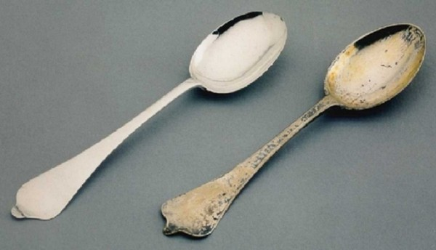
Patina Restore
Plastic Does Not Tarnish
Notes:
We have been lied to people. Some, even in this very room, would have you believe that the yellowing of your Apple II plastics is caused by oxidation of the fire retardant chemicals in the plastics.
Oxidation? Plastic? Really? Does that even make sense people? When something oxidizes, like silver, we call it tarnish. When is the last time you saw your grandparents plastic items from the 40’s tarnished? Yeah, I didn’t think so.
How about your LPs from earlier years? Scratching and wear I heard is a major issue, but never tarnish.

Slide 3

Patina Restore
Scientific Study
Notes:
By now I’m sure you’re asking yourself “So if not tarnish, then what is it exactly?” In hopes to better understand the problem Ultimate-Micro decided to conduct a scientific study. No expense or effort was spared in finding what the actual cause of this yellowing was. Several independent testing facilities were contracted, and each given samples of Apple II items which were in various states of yellowing.
After years of research, and countless dollars spent, each lab indecently came to the same conclusions: The yellowing isn’t caused by oxidation - as some would have you believe! But caused by the years of tears, stress, and aggravation the user experienced with trying to get the Apple II to do something, or overcome needless obstacle or poor programming. We’ve all been there…
***ERRORS NEXT 3 SCREENS***

Slide 4
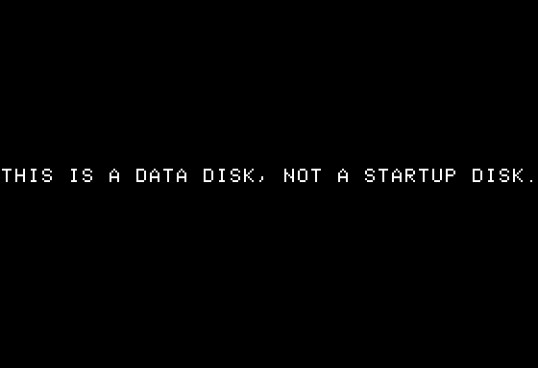
Patina Restore
Notes:
Riff….

Slide 5
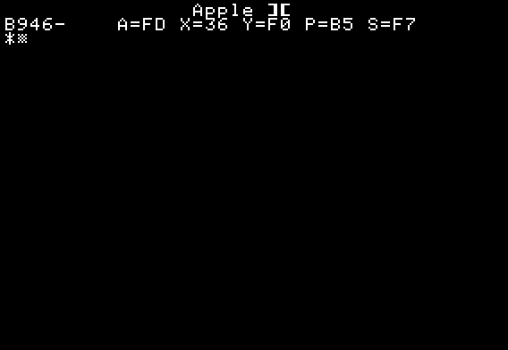
Patina Restore
Notes:
Riff….

Slide 6

Patina Restore
Notes:
Riff….
I digress…

Slide 7
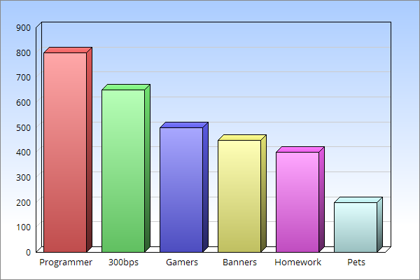
Patina Restore
Stress And Aggravation
Notes:
Yellowing isn’t caused by oxidation people. It’s called by stress and aggravation. Here’s a bar graph of our findings.
We found programmers’ systems and accessories suffered the worst yellowing. (use pointer)
Followed by people with 300bps modems.
Gamers.
People trying to print banners with old printer ribbons.
Kids who didn’t save their homework reports as often as they should have.
Followed by their pets who they themselves were then unable to eat their owner’s homework.
This is fact people. And if it’s a fact, am I lying?

Slide 8
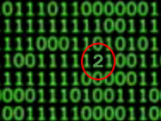
Patina Restore
Source Code AFTER Retrobrighting
Notes:
There’s been some speculation over the years that Retrobrighting could possibly cause a Black Hole, but this is still in the realm of speculation.
However, A Statistical Fact: Using the Quantum Field theory from Physics, it is possible that Retrobrighting your Apple II items can and WILL cause the ones and zeros in your CPU to randomly and intermittently become number twos, or worse – number threes!
I don’t need to tell the programmers in this room how catastrophic this can be.

Slide 9
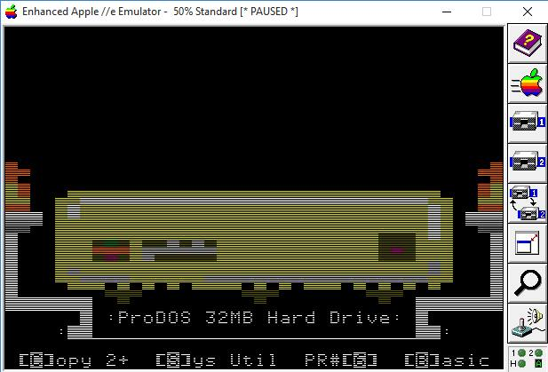
Patina Restore
Craig Bower’s YELLOW ProFILE Icon - Super Selector
Notes:
Some programmers have even come to this collusion independently themselves and offer color- corrected icons such as Craig Bower’s YELLOW ProFILE Icon in Super Selector.
Since this patch Super Selector has never had a bug or crash reported.

Slide 10
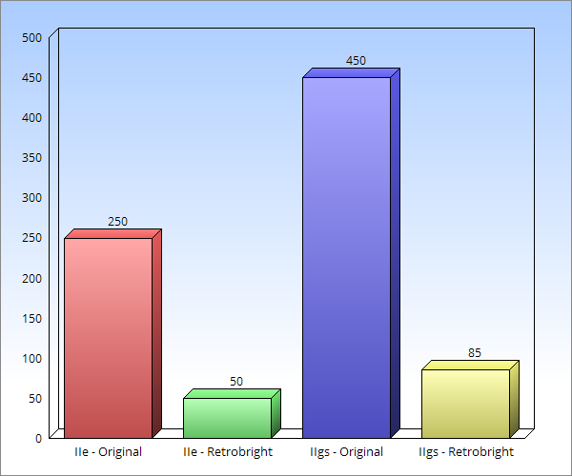
Patina Restore
Price AFTER Retrobrighting
Notes:
Prices are effected when items are Retrobrighted. They ALWAYS loose value!
Yellowing is a ploy from Apple to make you want to buy newer Macs, much like their early unreplaceable iPOD battery was a ploy to buy newer iPODs.
Retrobrighting is also recommended by those heavily invested in the Apple II futures market.
Have you even seen original an Apple II system from 1977 retrobrighted? Of course not! Don’t be fooled people!
This graph shows the market value of all 2016 Sales from eBay.
Original IIe $250. Retrobrighted $50. (pointer)
Original IIgs $450. Retrobrighted $85.

Slide 11
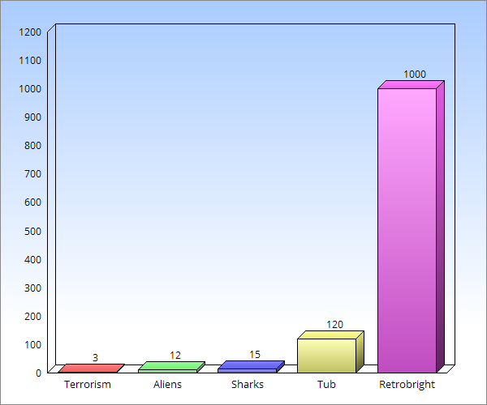
Patina Restore
Retrobrighting Hazardous?
Notes:
Some have asked “Is Retrobrighting hazardous?” Well this depends on your definition of “hazardous”.
Terrorism, alien abductions, sharks, and even the tub in your own bathroom – None of these compare to the possible and probable hazard that is Retrobrighting.
The government spent billions creating Homeland Security to protect us all from the dangers of Terrorism. Yet statically you have a higher chance of being maimed or killed while Retrobrighting. Yet NOTHING has been spent to protect or inform you about the very real hazards of Retrobrighting.
The chemicals used for Retrobrighting consists of hydrogen peroxide, a small amount of the "active oxygen" laundry booster as a catalyst, and a Ultraviolet light source.
First, let’s look at what Hydrogen is. It’s an element. It makes up stars which burn at millions of degrees.
It’s also a flammable or explosive gas when mixed with oxygen.
Let’s now examine UV light. As we all know it causes skin cancer. I’m pretty sure cancer is hazardous to my health.
So back to the question “Is Retrobrighting hazardous?” If you consider playing with cancer and explosive elements that burn at millions of degrees “hazardous” – then yes, Retrobrighting is possibly hazardous.
To point out exactly how hazardous, Javier used to have hair before he started Retrobrighting.
And he also used to be Korean!

Slide 12

Patina Restore
Retrobrighting Is Mutilation!
Notes:
Retrobryting is mutilation! Plain and simple – mutilation. You are using chemicals to forcefully remove your Apple’s natural coloring.
Retrobryting is also discriminatory! Really Apples have yellowing. They have been loved and used, not packed away in some temperature controlled storage unit. This yellow-shaming culture rampant in the Apple II Community, and facilitated by the few, needs to stop!
We should all now call Retrobryting the “RB-Word”. I identify as a Yellowed-Apple American and find the term “Retrobryting” offensive as I’m sure many Yellowed-Apple Americans in the audience with us today, and also watching us on the internets also find the term offensive.
Ok, enough attacking the attackers. I apologize for the perceived negativity so far, but this is something very close to my heart and soul.
Now...

Slide 13
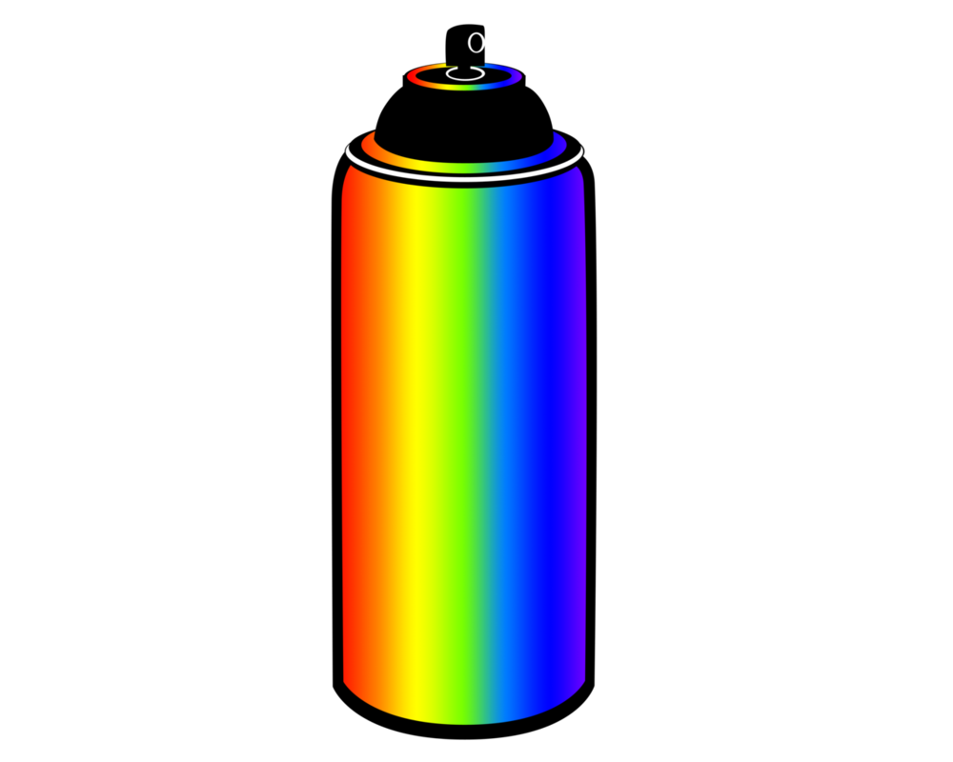
Patina Restore
The Solution!
Notes:
How to solve this issue besides ending the discrimination and mutilation? Plain and simple - Patina Restore!
A new product formulated by us to restore your Apple to its original, natural yellowed state. Now only $99.99!
Each can is specially formulated with the tears from software developers, burnt fingers tips and hang nails from hardware designers, kid’s frustrated screams, and dried up joystick oil.
You will once again be able to proudly look upon your Apple II in all its dull yellow glory, thanks to Patina Restore!
(hold up can, labels falls off to reveal it’s paint. Act nervous, scurry to reaffix label, then quickly end!)

